Slide 1
MATLAB Analysis Tools
A User’s Guide
11-25-2019
Version 1.0

Slide 2
Tool Locations
MATLAB/Printing
MATLAB/Analysis
depends on MATLAB/Utilities

Slide 3
Outline
Printing tools
PrepForPrint
Kprint
Add_print_callbacks
Analysis tools
add_analysis_callbacks

Slide 4
PrepForPrint
The workhorse of making briefing-ready plots quickly and consistently
Best practice is to call this function with no arguments near the beginning of your script.
Returns a structure (initialized with defaults) with many different properties relevant for sizing text and lines for easier viewing in briefings.
You can modify these values as you see fit for your particular briefing needs
When you have a plot you want to convert to an image or screenshot, you can call PrepForPrint with a figure number/handle and this structure, and PrepForPrint will use the values in the structure and update all relevant objects in the figure.

Slide 5
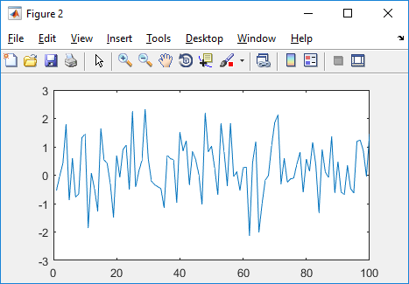
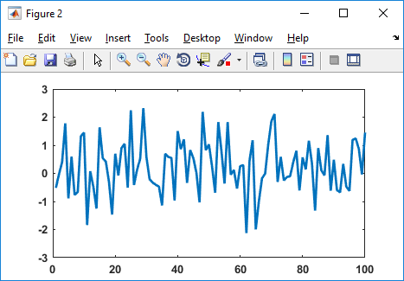
PrepForPrint
close all; clear all; clc
pp = PrepForPrint; % initialize default structure
figure;
plot(randn(1,100))
PrepForPrint(gcf,pp) % applies properties in “pp”
% to all relevant objects in
% current figure

Slide 6
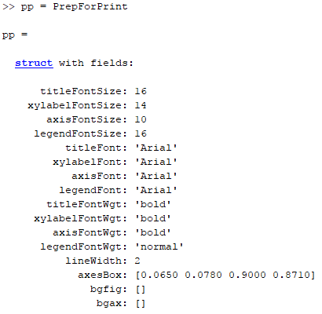
PrepForPrint
pp = PrepForPrint % initialize default structure

Slide 7
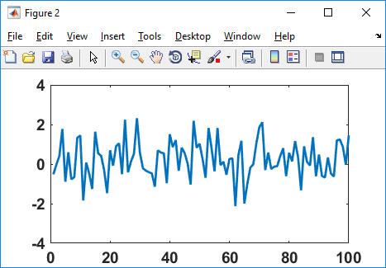
PrepForPrint
Update any values in the PrepForPrint structure “pp” and re-run PrepForPrint(gcf,pp) to apply changes:
pp.axisFontSize = 10
pp.axisFontSize = 14

Slide 8
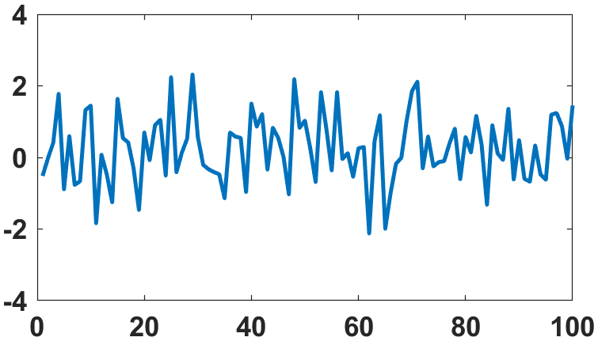
kprint kprint(fignum, filename, dpi (integer))
The simplest method for getting cropped image files of a figure programmatically
kprint(gcf,'test.png',180)

Slide 9
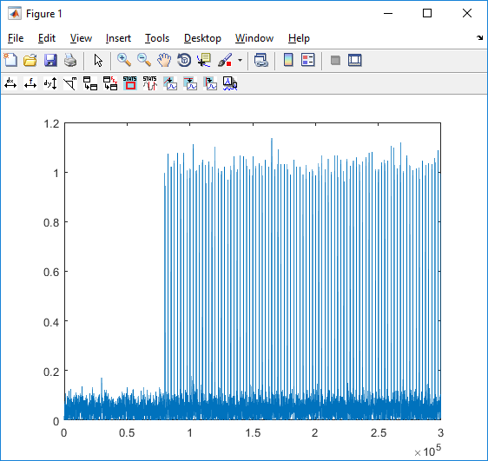
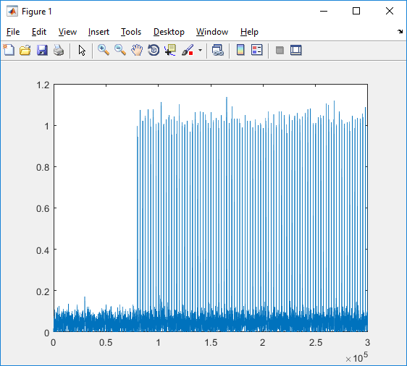
add_print_callbacks add_analysis_callbacks
figure;
% add the following lines right after you create a figure
add_analysis_callbacks;
add_print_callbacks;

Slide 10
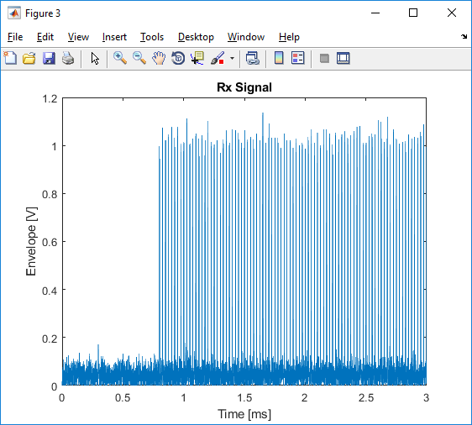
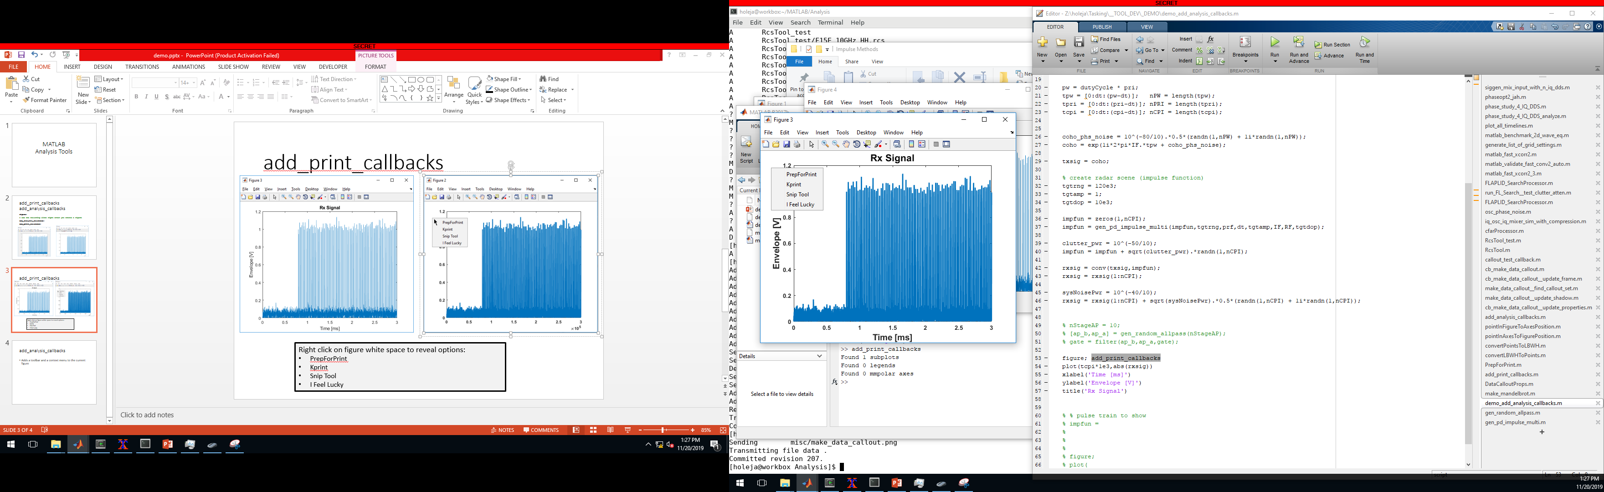
add_print_callbacks
Right click on figure white space to reveal options:
PrepForPrint
Kprint (starts a series of dialogs to get filename)
Snip Tool (starts Windows Snip Tool)
I Feel Lucky (automatically generates a filename from title and calls kprint)

Slide 11
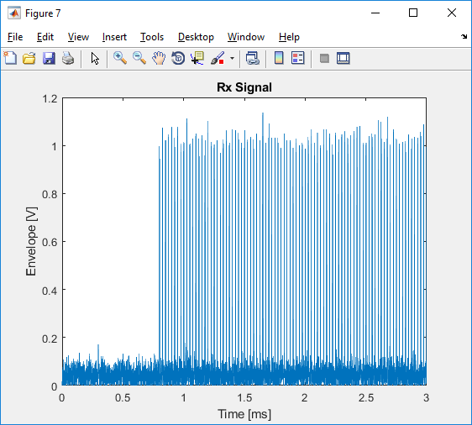
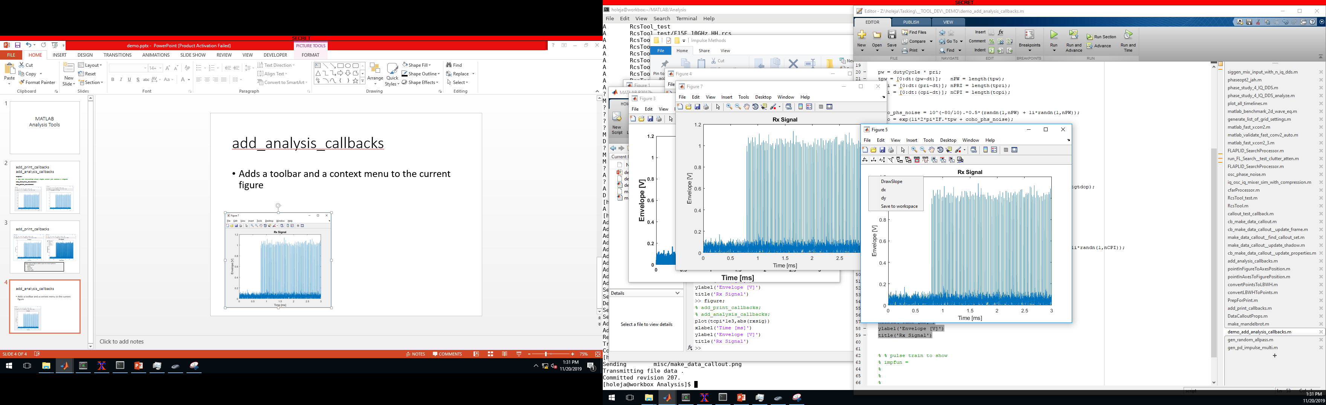
add_analysis_callbacks
Adds a toolbar and a context menu to the current figure

Slide 12
add_analysis_callbacks
Adds a toolbar and a context menu to the current figure
Tooltips will appear if you hover the mouse over any buttons
Compute dx

Slide 13
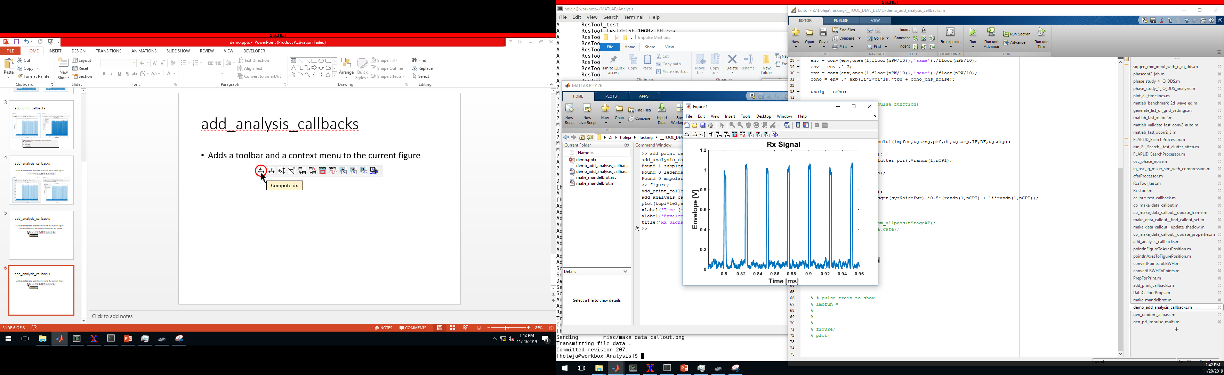
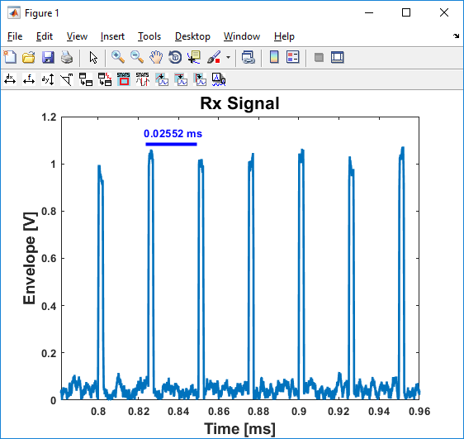
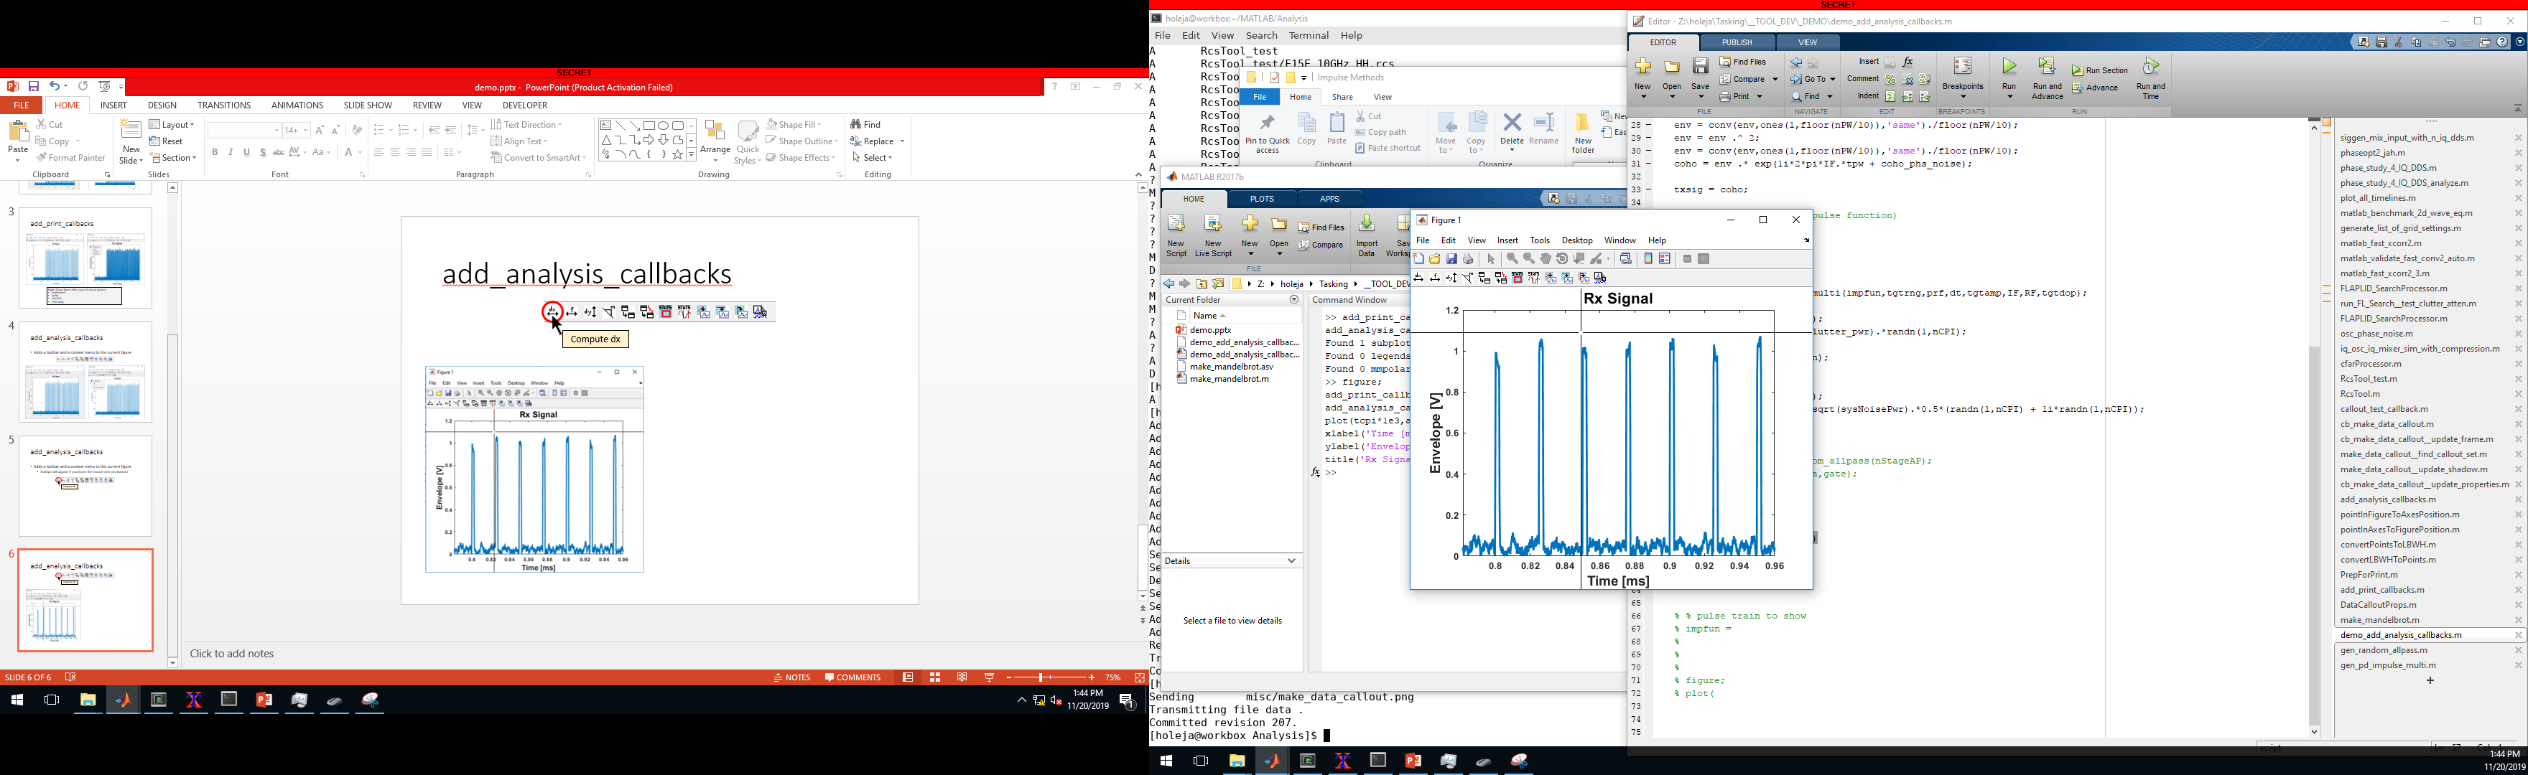
add_analysis_callbacks
Compute dx
Step 1)
Step 2)
Result will pull the units from the xlabel if the units enclosed with parantheses or square brackets.

Slide 14
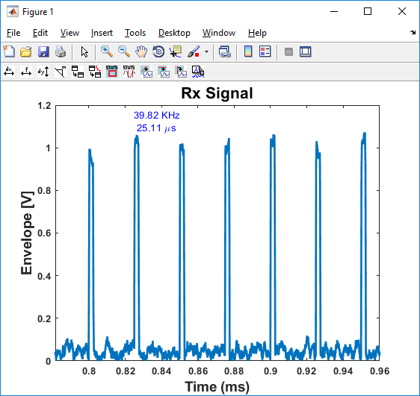
add_analysis_callbacks
Compute frequency
Step 1)
Step 2)
Works the same way as “Compute dx”, but will also compute the corresponding frequency of the drawn time period. Requires the x-axis to be units of time.

Slide 15
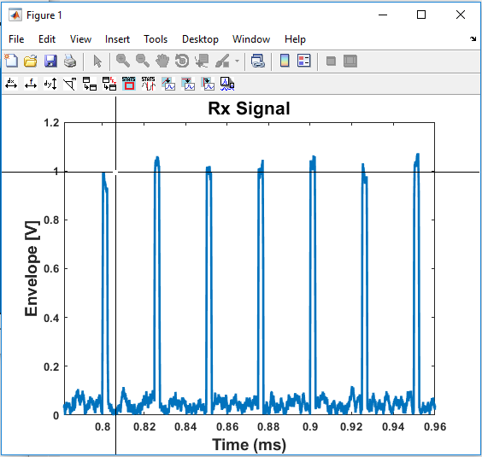
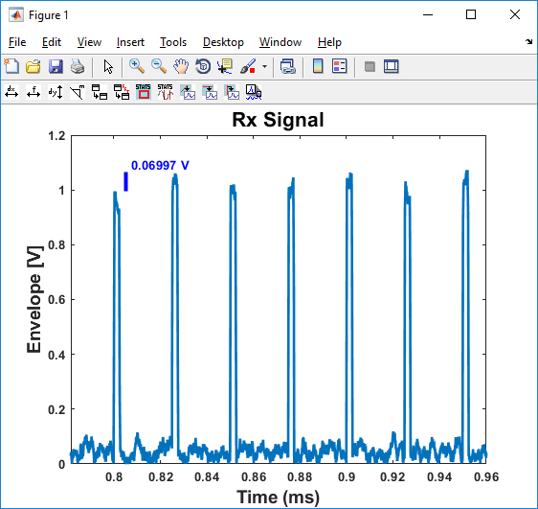
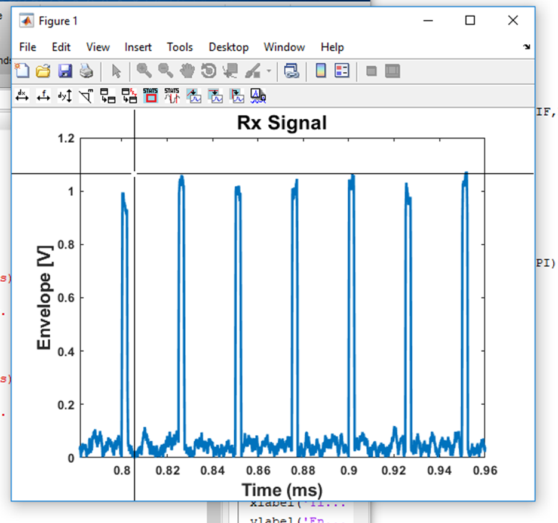
add_analysis_callbacks
Compute dy
Step 1)
Step 2)

Slide 16
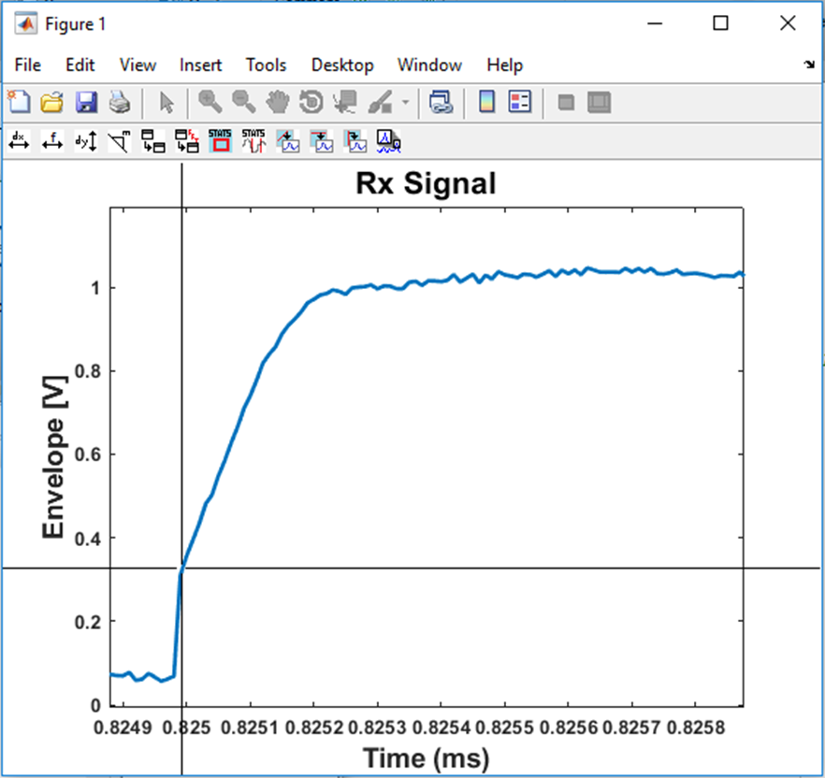
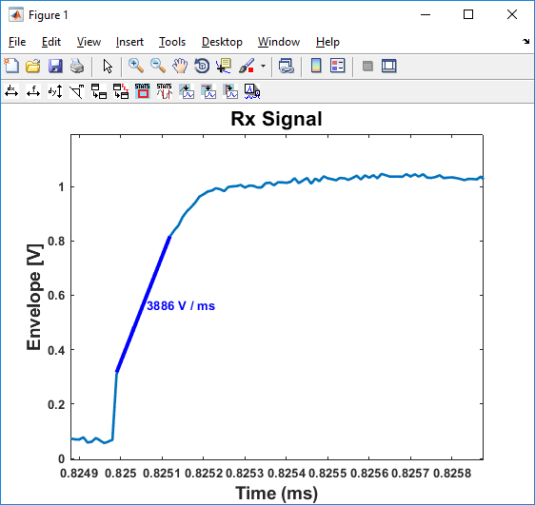
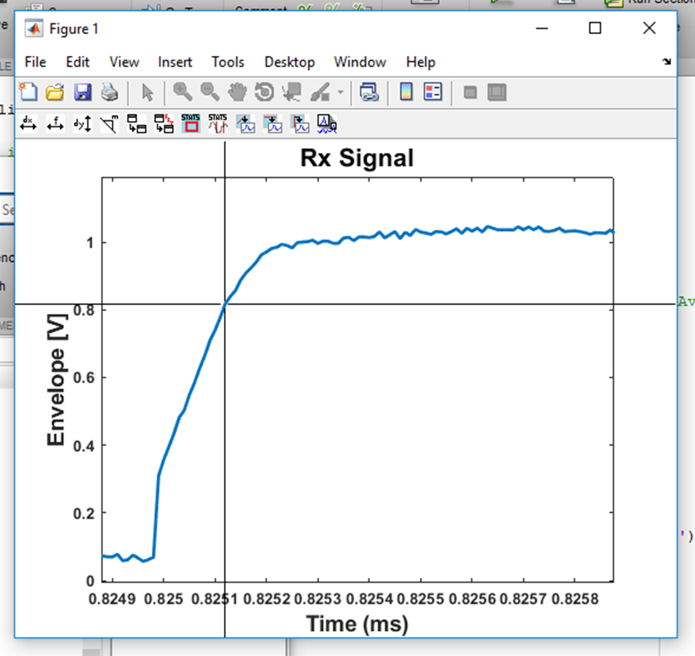
add_analysis_callbacks
Compute slope
Step 1)
Step 2)

Slide 17
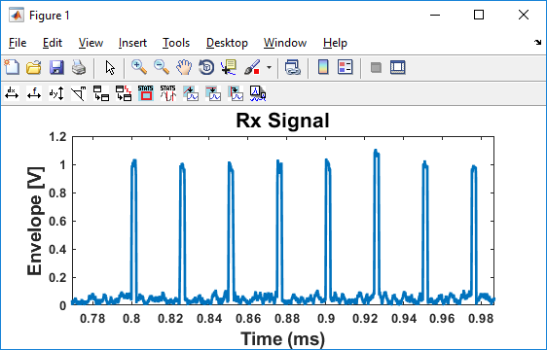
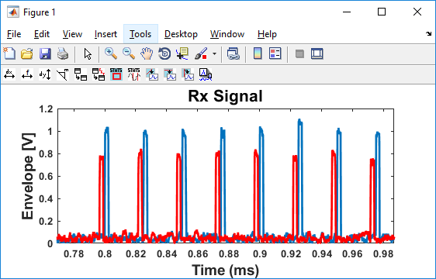
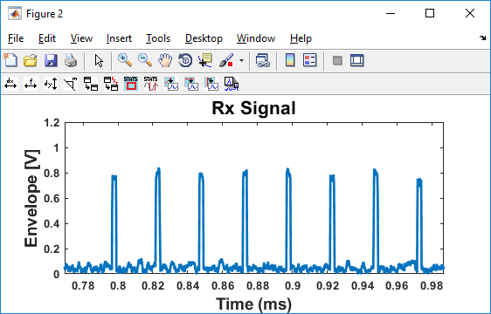
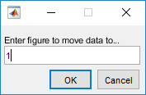
add_analysis_callbacks
Move data to another figure
Figure 1
Figure 2
Step 1)
Click button on figure with data to be moved.
Step 2)
In the popup dialog, type the figure number where this data is to be moved.

Slide 18
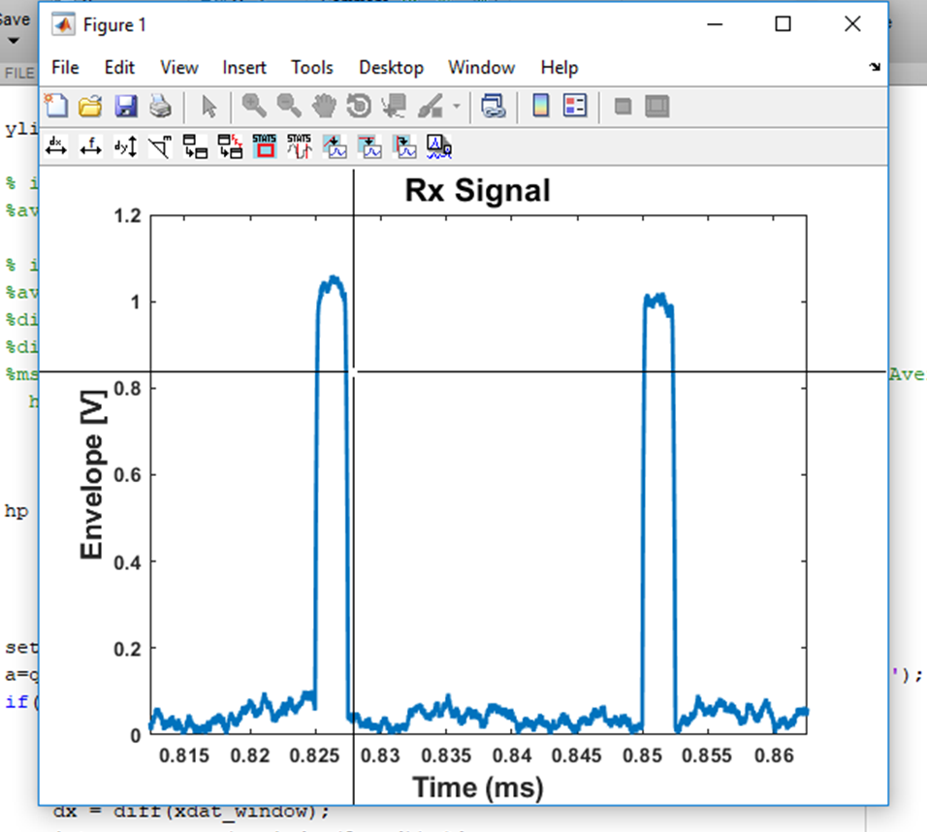
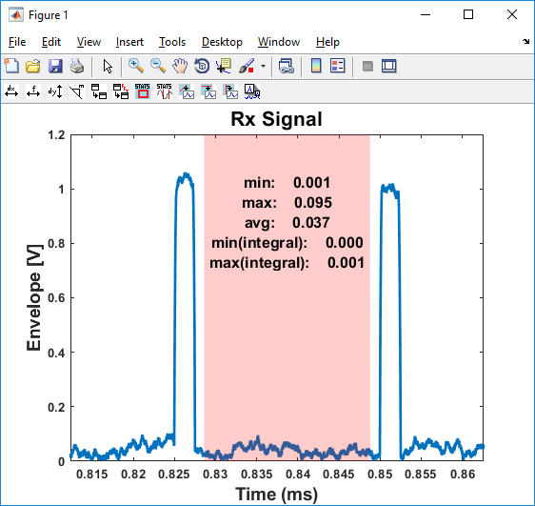
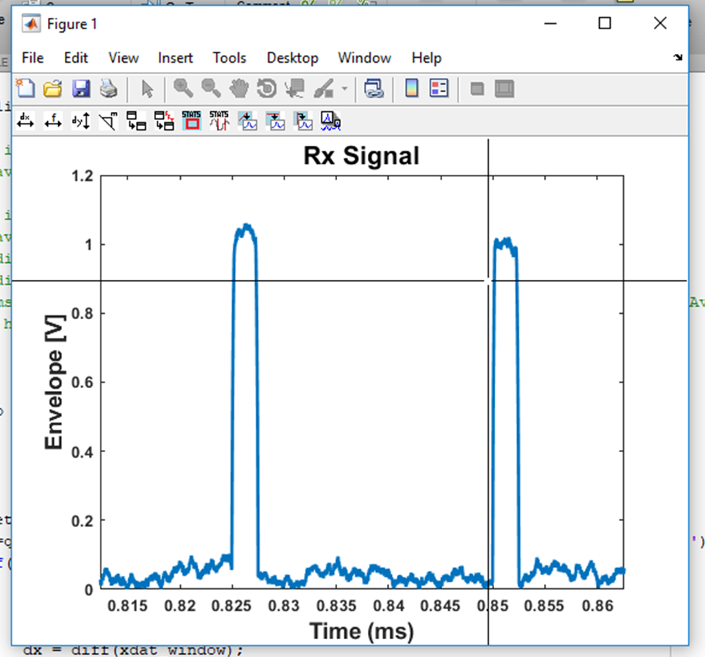
add_analysis_callbacks
Compute Stats within Region (line)
Step 1)
Step 2)

Slide 19
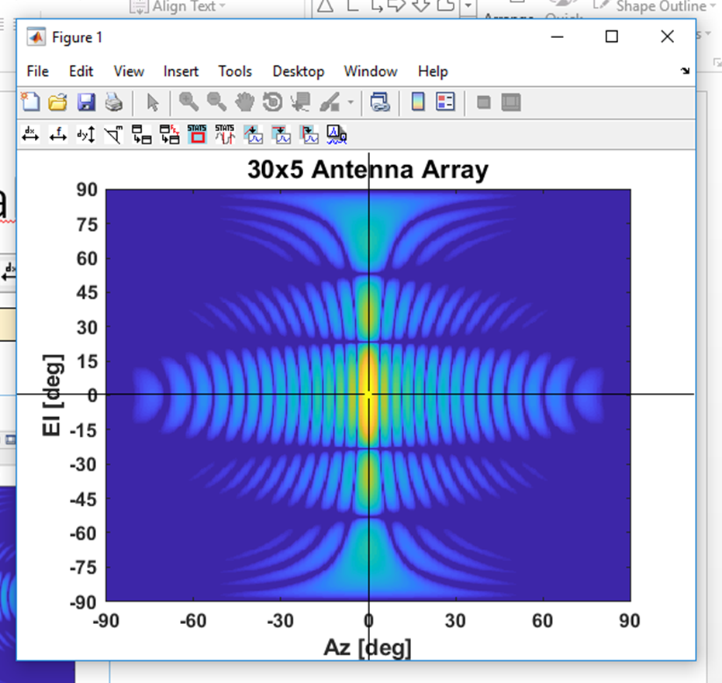
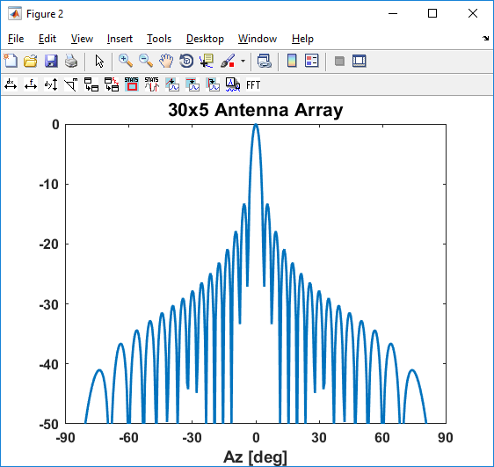
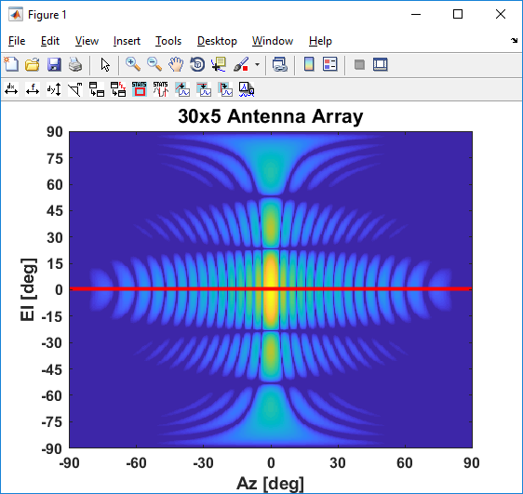
add_analysis_callbacks
Grab Slice (horizontal) From Image Data
Step 1)
New figure pops up with labels from image plot showing the horizontal slice

Slide 20
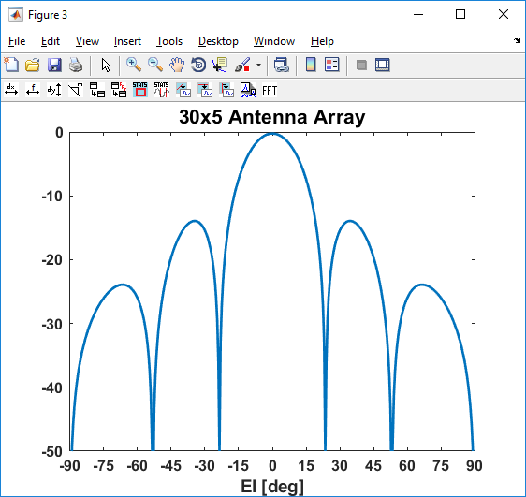
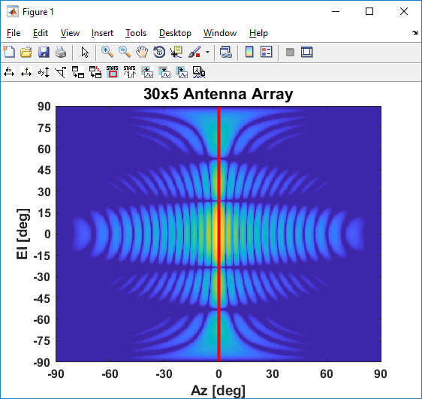
add_analysis_callbacks
Grab Slice (vertical) From Image Data
Step 1)
New figure pops up with labels from image plot showing the vertical slice

Slide 21
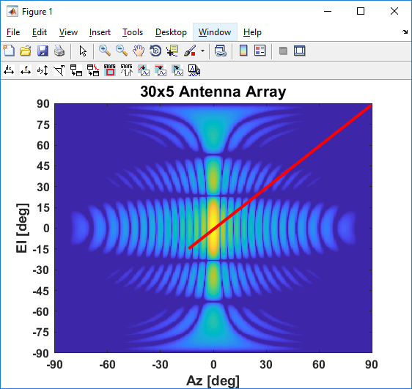
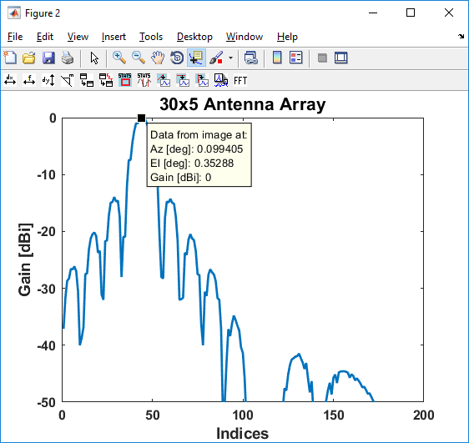
add_analysis_callbacks
Grab Slice (slant) From Image Data
2nd point
1st point
New figure pops up with data from the slant cut starting at first clicked point. Using the data cursor tool, you can inspect the X,Y,Z points.

Slide 22
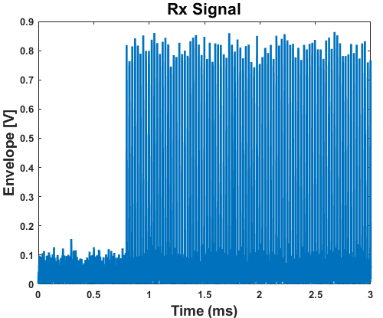
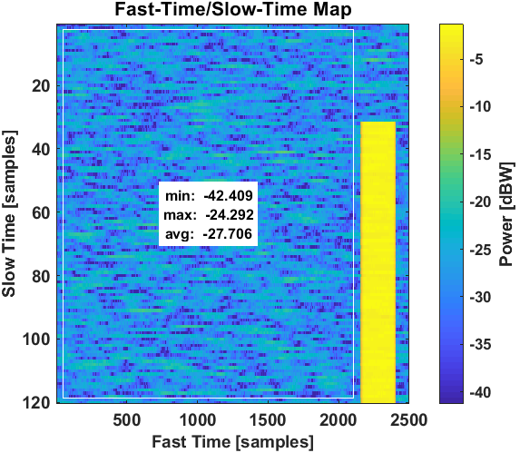
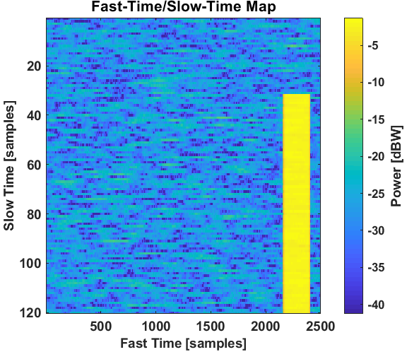
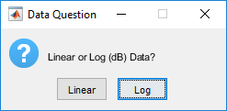
add_analysis_callbacks
Step 1) With two clicks, select area
Compute statistics within Area (Image)
FTST
Step 2) Select the data scaling of the underlying data.
With this tool, we can measure statistics within an area of a fast-time/slow-time map or range-Doppler map. After you select the box around the data, a dialog box will ask if the data is linear or log-scaled.

Slide 23
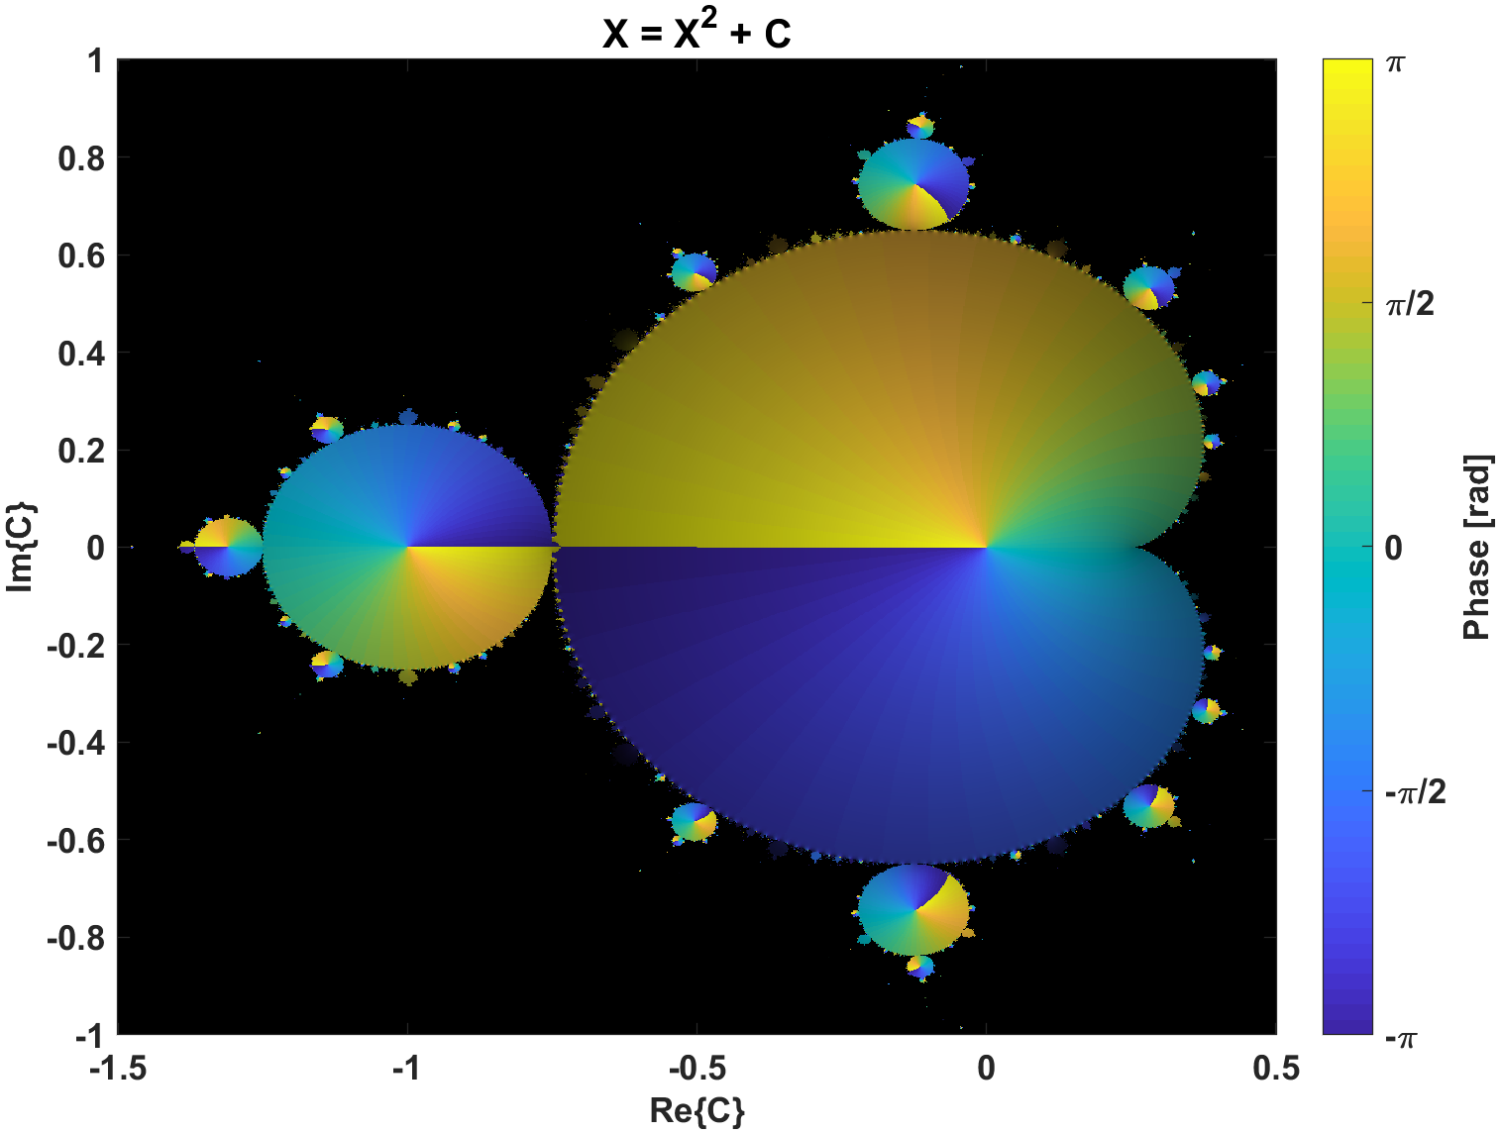
add_analysis_callbacks
Make a data callout in figure

Slide 24
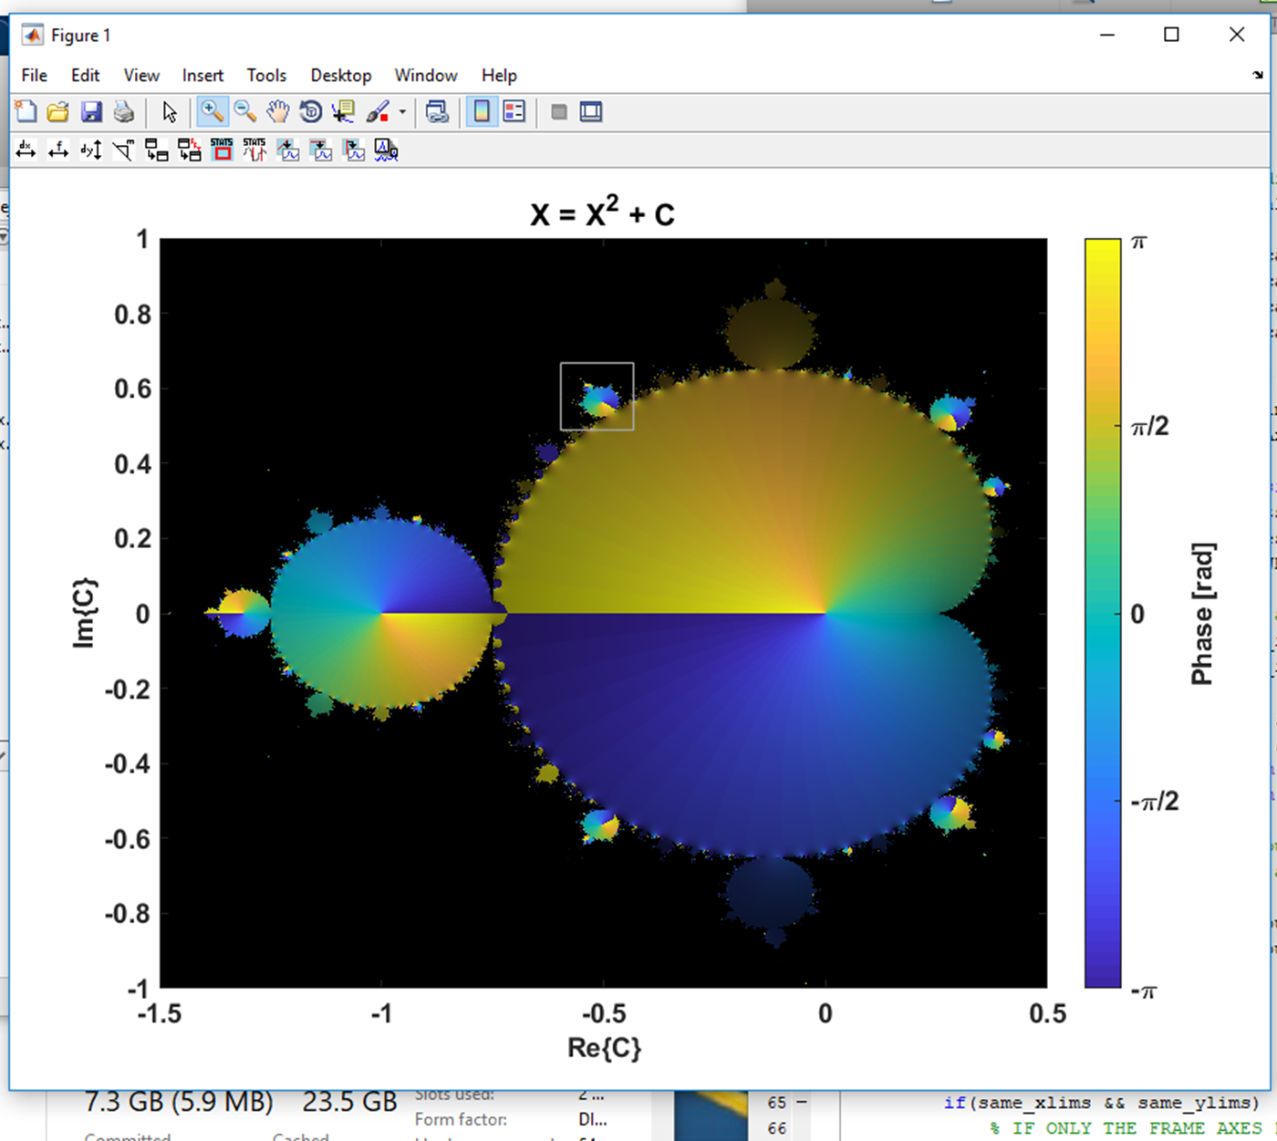
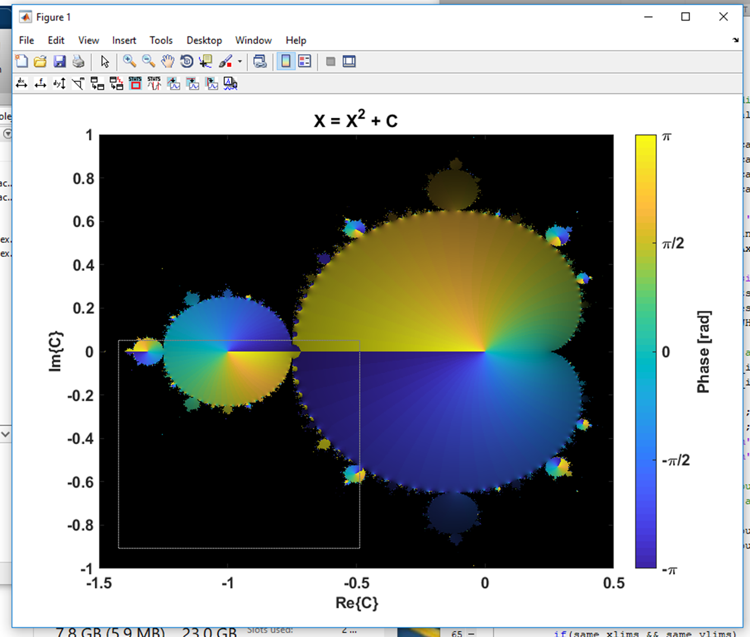
add_analysis_callbacks
Make a data callout in figure
Step 1) Draw a box around area to zoom into with callout
Step 2) Draw a box anywhere in the figure where the callout should go

Slide 25
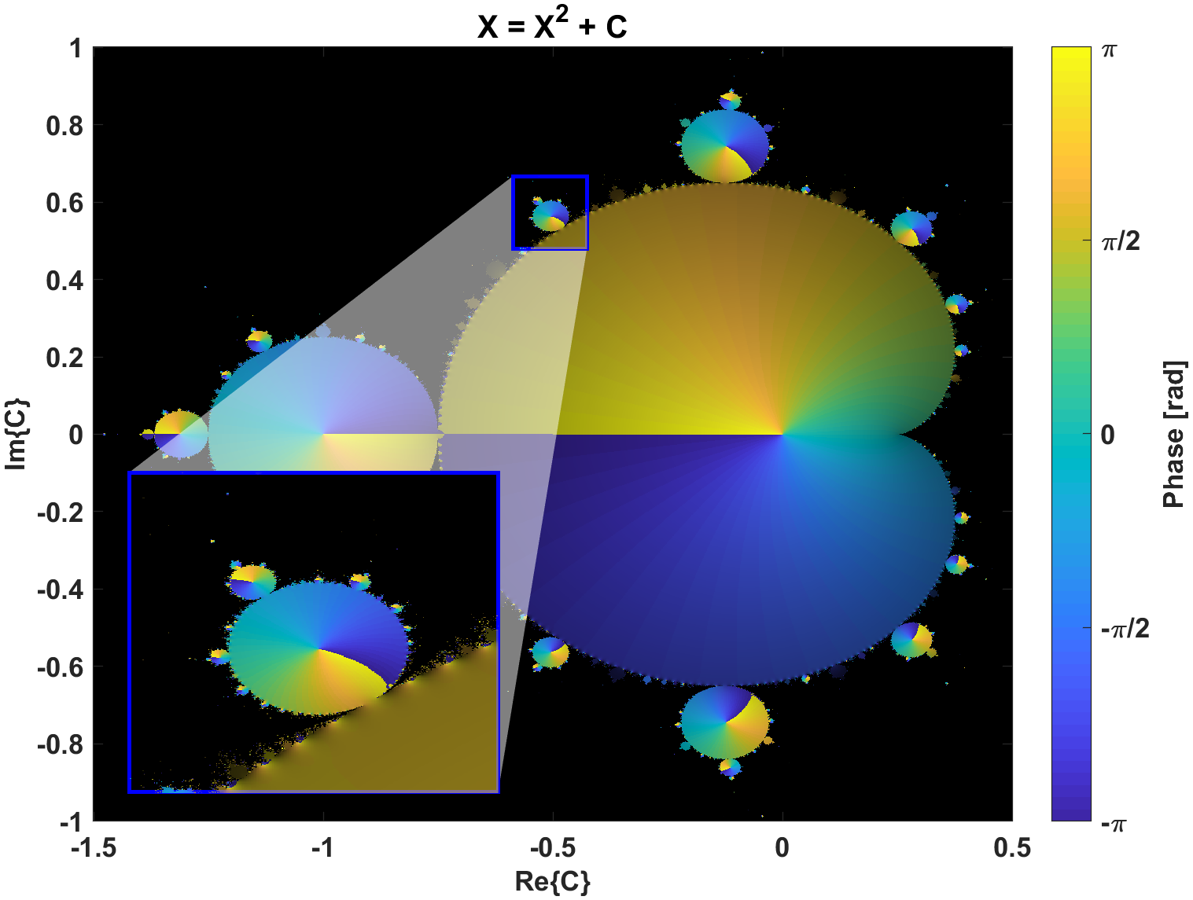
add_analysis_callbacks
Make a data callout in figure
This tool has a variety of ways to customize and modify that will be discussed next.

Slide 26
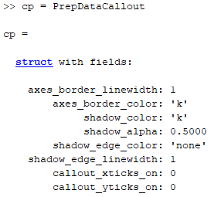
add_analysis_callbacks
Make a data callout in figure
Run the following code in your script or command window to get a structure of properties pertaining to the appearance of the data callouts in the plot:
cp = PrepDataCallout

Slide 27
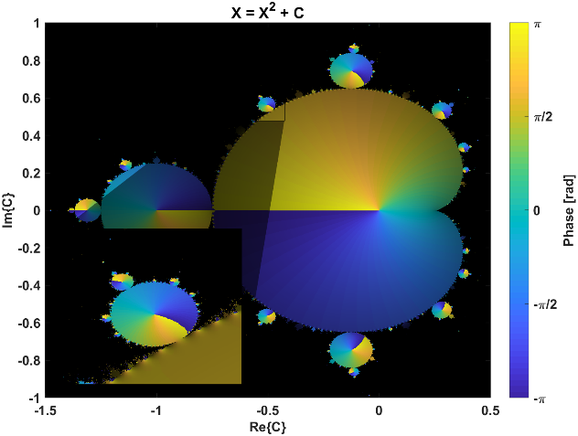
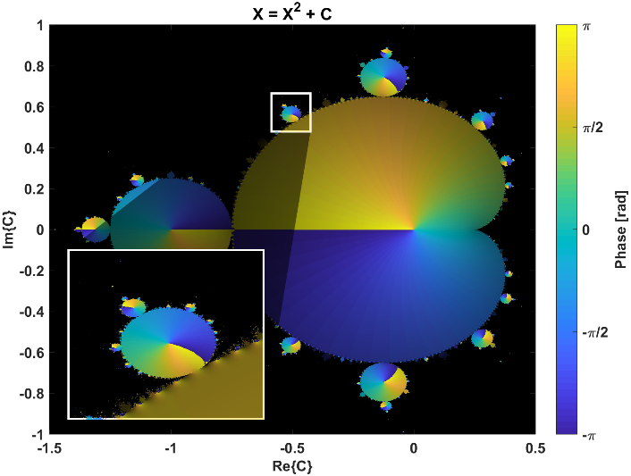
add_analysis_callbacks
Now you can modify any of these properties are re-apply them to the callouts in a particular figure
cp.axes_border_color = ‘w’
cp.axes_border_linewidth = 2
PrepDataCallout(gcf,cp)
Make a data callout in figure

Slide 28

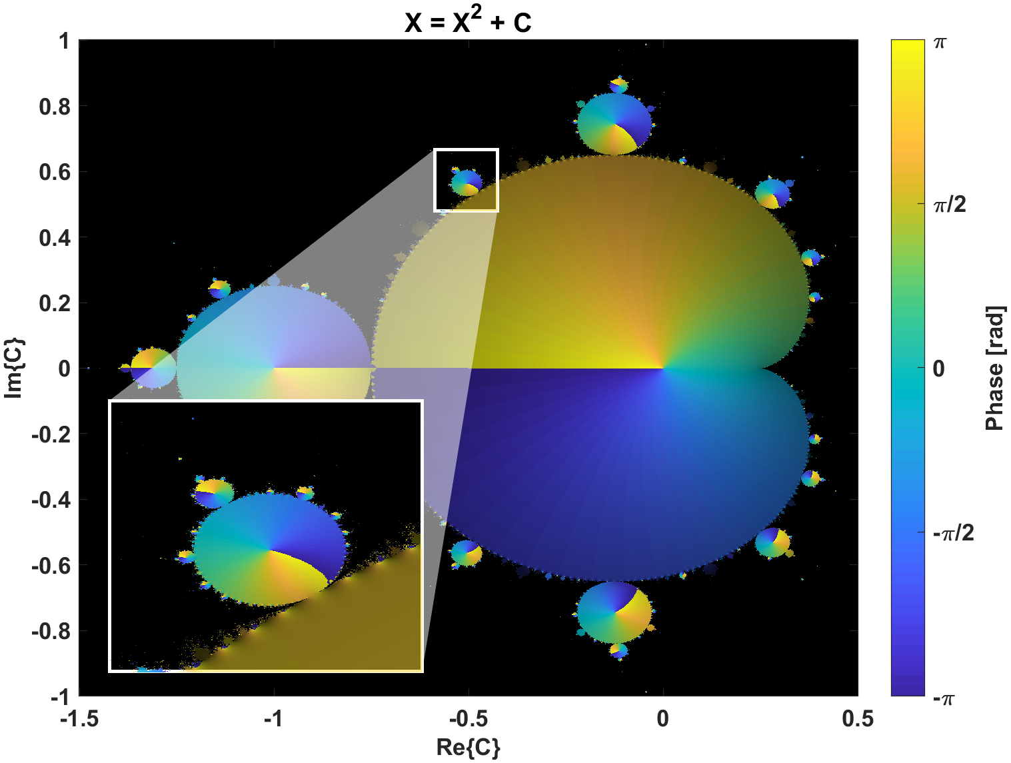
add_analysis_callbacks
Make a data callout in figure
cp.shadow_color = ‘w’
PrepDataCallout(gcf,cp)

Slide 29
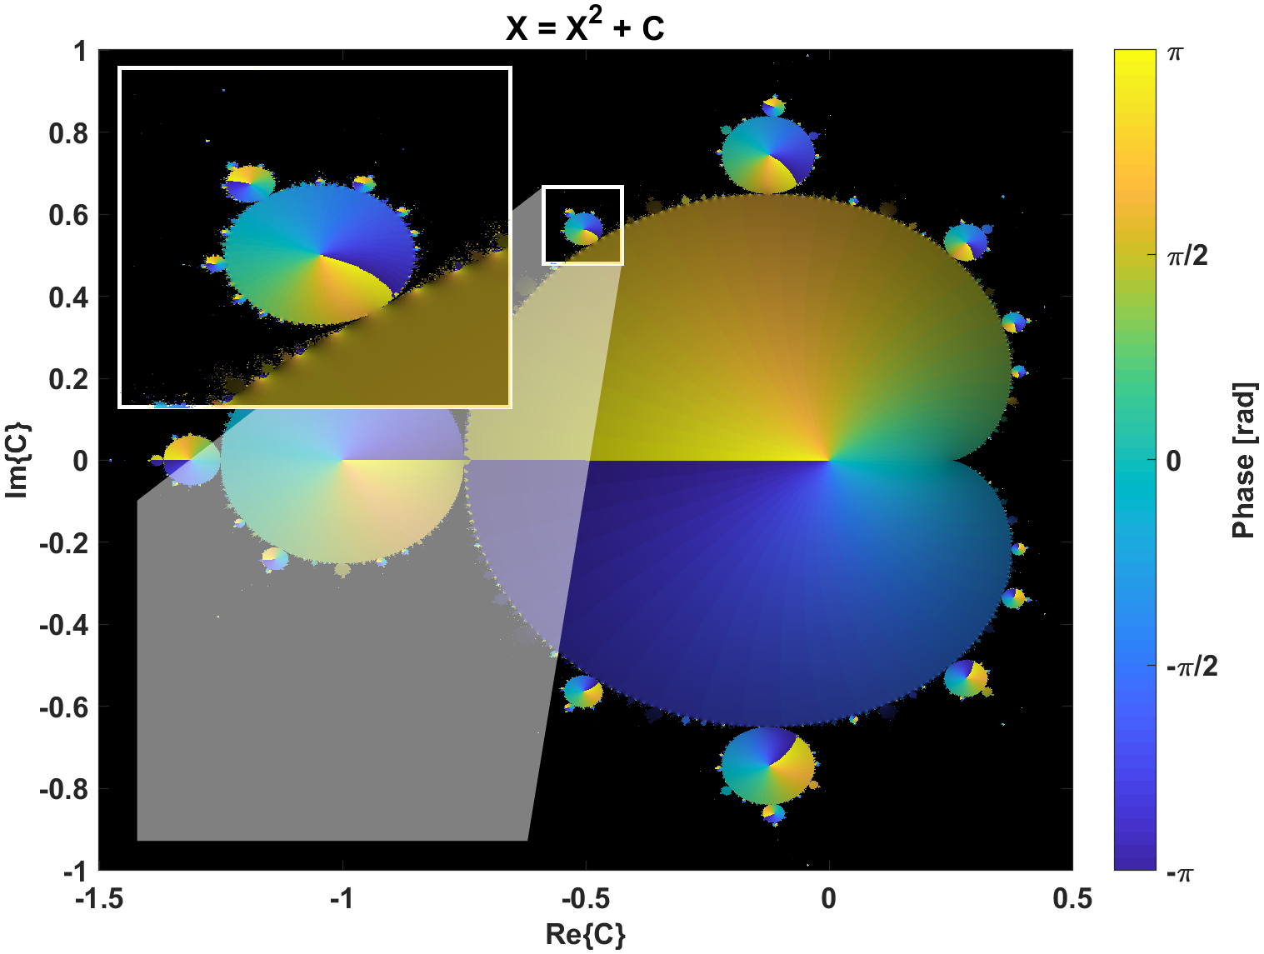
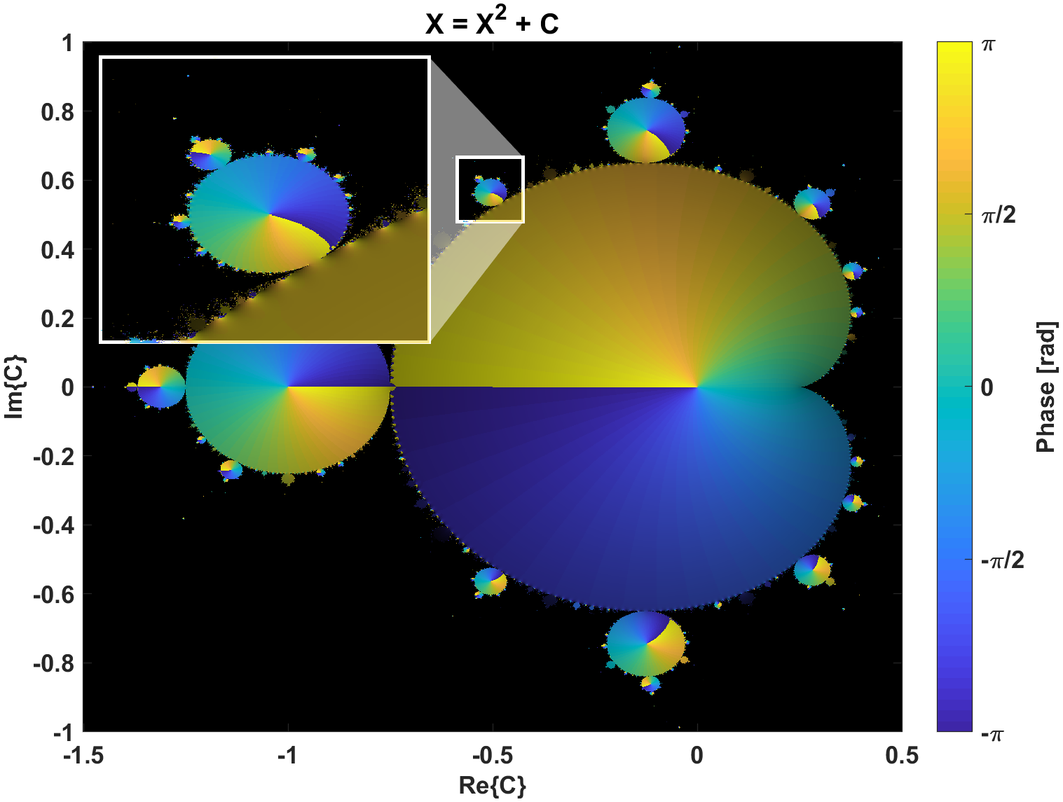
add_analysis_callbacks
The frames are actually separate axes objects, and the shadow is a patch object inside the original axes.
If you move or resize the boxes, you can right-click on the object to open the context menu and then click on “update” in the list. This will apply the appropriate updates to the shadow and other plot to make things look right.
Make a data callout in figure

Slide 30
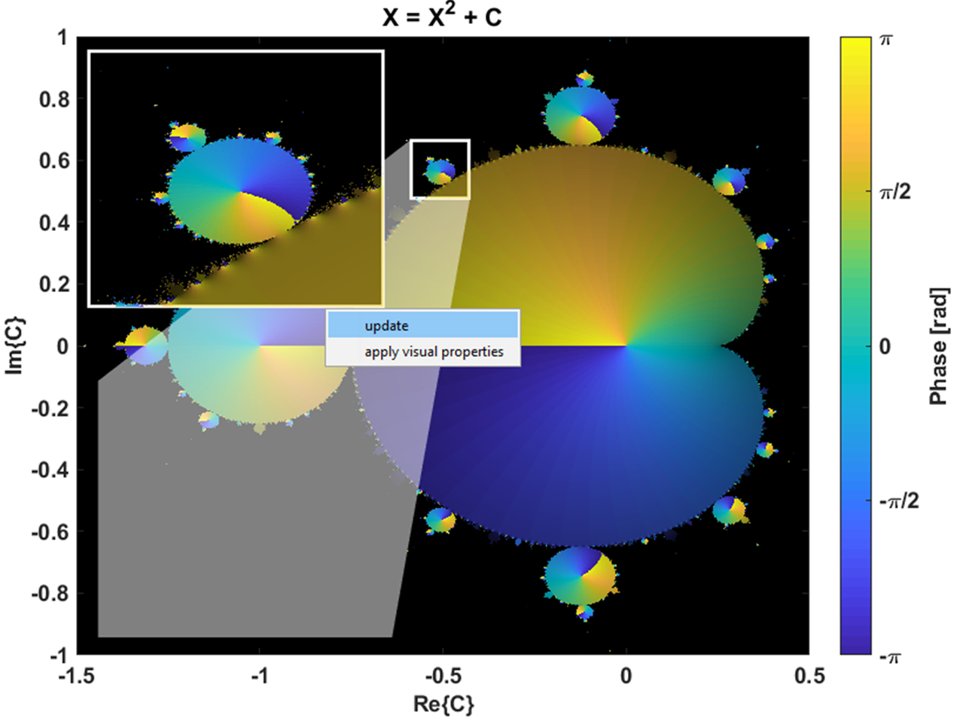
add_analysis_callbacks
Moved the callout so need to update the shadow…
Right click on the callout axes (a little tricky with image data getting in the way; need to click on the border)
Make a data callout in figure

Slide 31


add_analysis_callbacks
Moved the location of the frame in the original data. By right-clicking on this frame axes and selecting “update” in the context menu, the data will recenter to where the frame axes is, and then also update the shadow.
Make a data callout in figure

Slide 32



add_analysis_callbacks
Using the “Pan” tool (hand tool) in the callout or frame axes will allow you to get your data centered just right
Make a data callout in figure
But now the callout and frame axes are not consistent.
So right-click on the callout axes and click “update”.
Now the frame axes is consistent with the callout axes

Slide 33


add_analysis_callbacks
You can also move and resize the frame axes and when you update the plot (right-click on the frame axes and select “update”), the data in the frame axes will properly orient the data
Make a data callout in figure
Now the frame axes is aligned again, the shadow has updated, and the callout axes data is consistent with the frame axes.

Slide 34

add_analysis_callbacks
Make a data callout in figure
You can do callouts within callouts.

Slide 35

add_analysis_callbacks
Make a data callout in figure
Because the callout is a separate axes object, it can be modified like any axes object (set ticks, labels, etc)
% select callout axes and
% save handle
hax_callout = gca;
% re-assign for sake of PPT
% textbox
h = hax_callout;
set(h,’xtick’,-.6:.03:-.4)
set(h,’ytick’,.4:.02:.7)
set(h,’xcolor’,[.4 .4 1])
set(h,’ycolor’,[.4 .4 1])
grid(h,’on’)
set(h,’GridAlpha’,0.4)
PrepDataCallout(gcf,cp)

